Slide 1

SCTR’s Pune Institute of Computer Technology, Pune electronics and Telecommunication engineering
“Dexterous”
By:
1) Vishal Bhokre 32112
2) Vedant Butala 32113
3) Sumedh Kasat 32134

Slide 2
Introduction
Challenge and Innovation :
Crafting a 6-DOF robotic arm with ESP32 and Raspberry Pi 3 is a thrilling challenge.
Integrating these technologies adds complexity and sparks innovation.
Skill Development :
Involves honing mechanical, electronic, and coding skills.
Opportunities to master ESP32 and Raspberry Pi 3 intricacies.
Dynamic Control :
Achieving a 6-DOF setup allows for intricate control and dynamic response.
Witnessing precise arm responses becomes a tangible achievement.
Future Automation Insight :
Offers deep insight into future automation with ESP32 and Raspberry Pi 3.
Gaining practical knowledge positions you as a contributor to future advancements.
Creating a 6-DOF robotic arm with locomotion using ESP32 and Raspberry Pi 3 isn't just a project; it's a transformative experience propelling you into cutting-edge technology.

Slide 3
Literature survey
Introduction :
Interest in versatile robotic arms with locomotion, merging agility and mobility.
Focus on 6-DOF arms using ESP32 and Raspberry Pi 3.
Study 1 : "Advanced Robotic Arm Control via IoT with ESP32 and Raspberry Pi 3" (2020)
Features: 6 DOFs, ESP32, Raspberry Pi 3, IoT connectivity.
Insight: Demonstrates advanced control capabilities through IoT.
Source: Academia.edu
Study 2 : "Affordable 3D-Printed 6-DOF Robotic Arm with ESP32 and Raspberry Pi 3" (2021)
Features: 6 DOFs, 3D-printed, Bluetooth control.
Insight: Highlights affordability and flexibility in a 6-DOF context.
Source: Hiwonder

Slide 4
Literature survey
Study 3 : "Integrating Locomotion with a 6-DOF Robotic Arm using ESP32 and Raspberry Pi 3" (2019)
Features: 6 DOFs, mounted on mobile platform, synchronized control with Raspberry Pi 3.
Insight: Successful integration of arm manipulation with mobile locomotion.
Source: Research Hub
Key Trends and Findings : ESP32, Raspberry Pi 3 common for control, showcasing synergy. 3D printing vital for cost-effective 6-DOF fabrication. Trend towards integrating 6-DOF arms with locomotion.
Conclusion : Advances in 6-DOF arms with locomotion, using ESP32 and Raspberry Pi 3. Trends include advanced control, affordability, and arm-locomotion integration. Future research opportunities in refining controls and expanding applications.

Slide 5
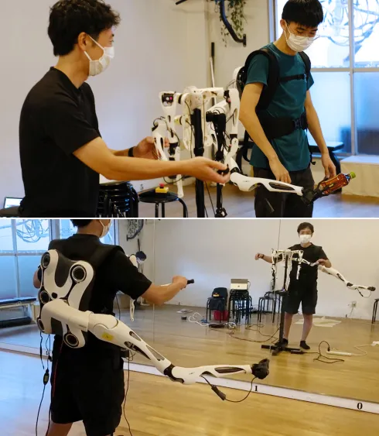
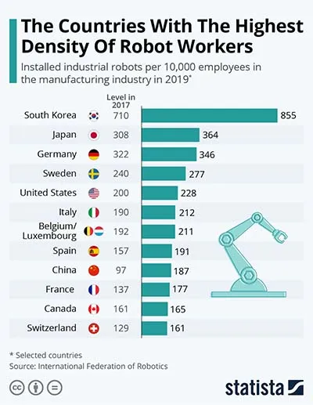
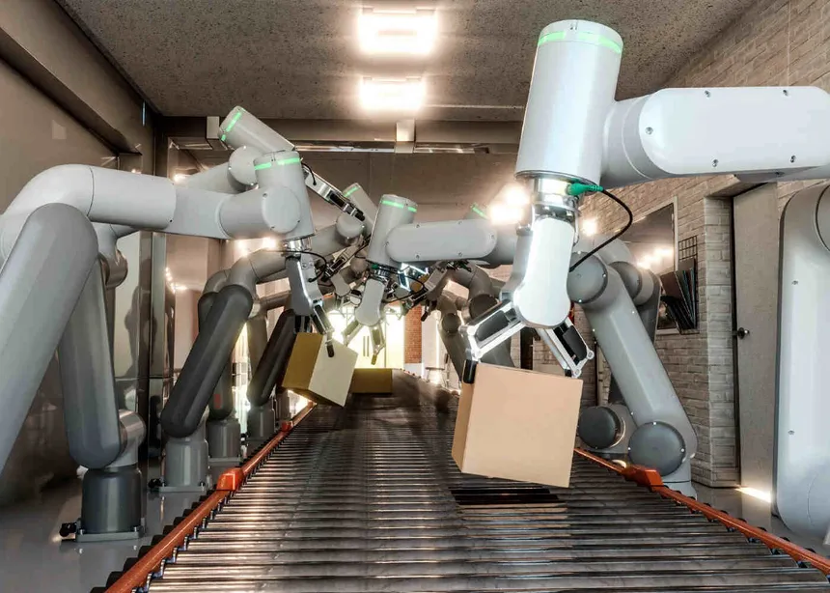
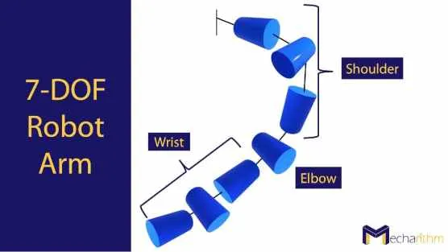

Slide 6
Objectives
Precise Control : Ensure smooth and accurate movement using ESP32 and servo motors.
Object Manipulation : Design the arm to grasp and manipulate objects of different shapes and sizes.
Wireless Communication : Utilize ESP32 for wireless control via Wi-Fi or Bluetooth, supporting joystick, web app, or smartphone interfaces.
User-Friendly Interface : Create an intuitive control interface for users of all skill levels.
Power Efficiency : Optimize battery life or power supply for extended operation.
Modular Design : Enable future upgrades with a modular platform for additional sensors, tools, or attachments.
Locomotion Integration : Implement effective movement capabilities for the robotic arm.
End-Effector Customization : Allow customization of end-effectors for various tasks.
Safety Measures : Integrate safety features for obstacle detection and secure operation.
10-01-2024

Slide 7
Block Diagram /working model with animation
10-01-2024

Slide 8
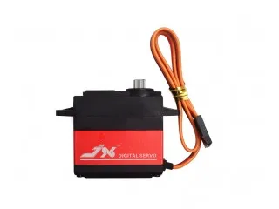
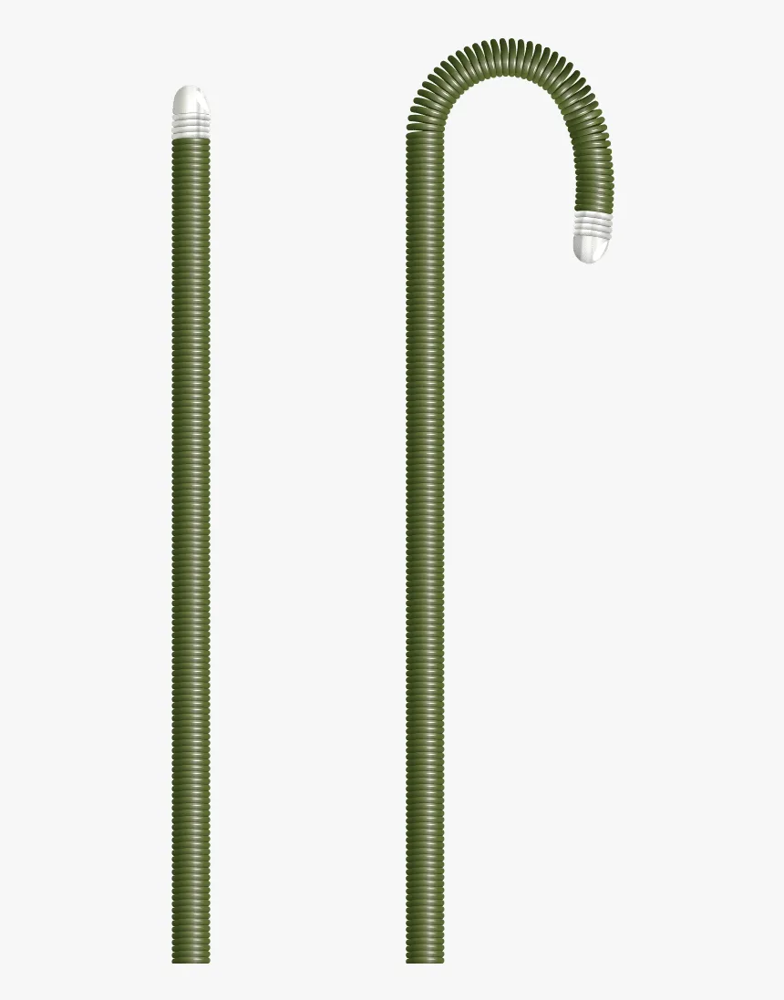
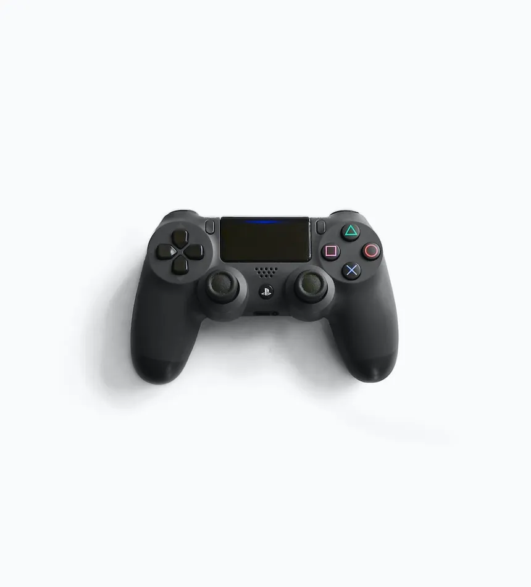
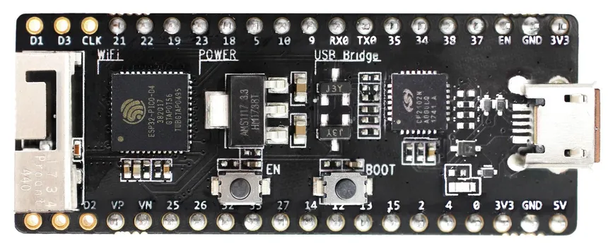


Slide 9
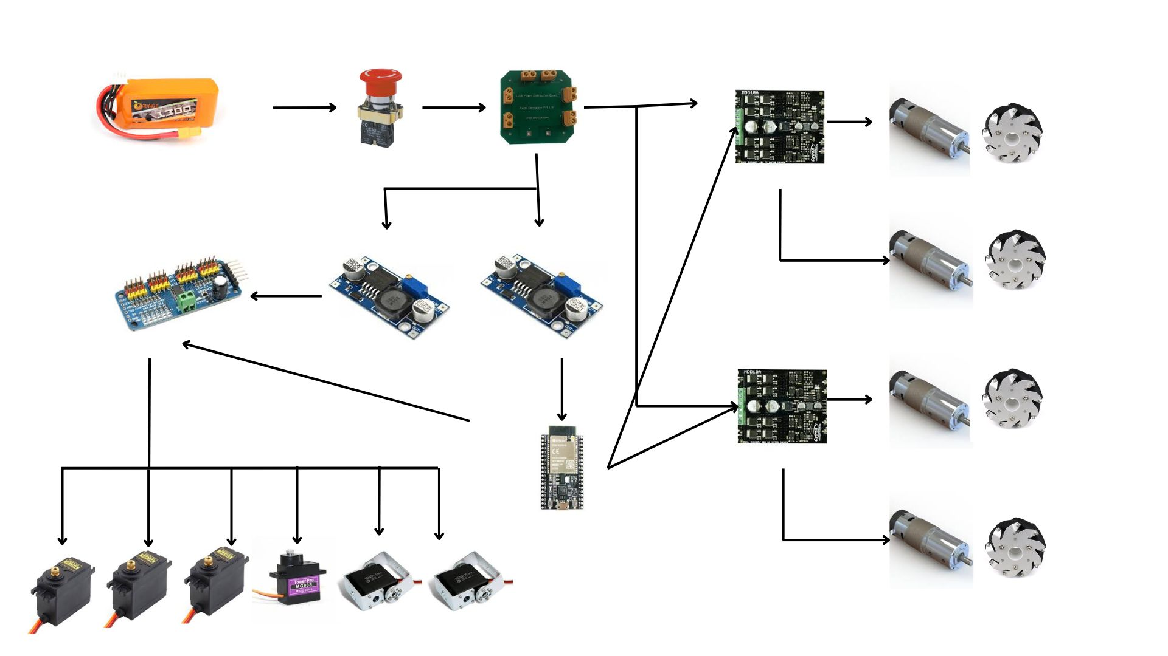
Detailed Circuit Diagram :

Slide 10
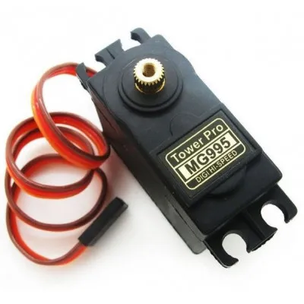
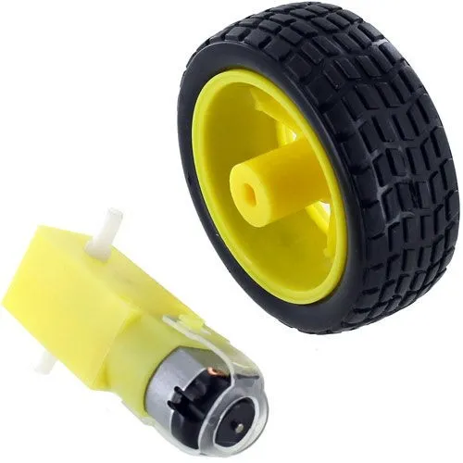
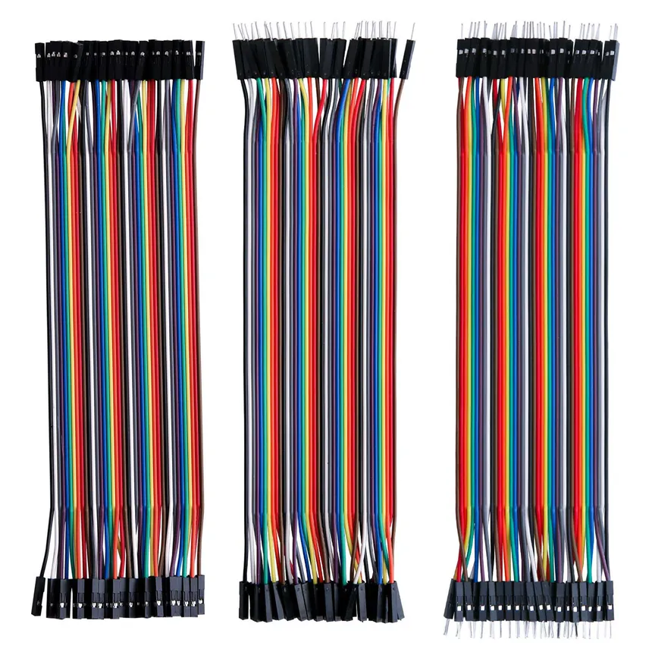
resources Required
Hardware with specification
ESP-32 Module
2) Servo Motors - MG995
3) Toy Motors and Wheels
4) Jumper Cables

Slide 11
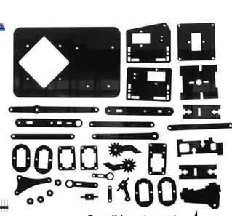
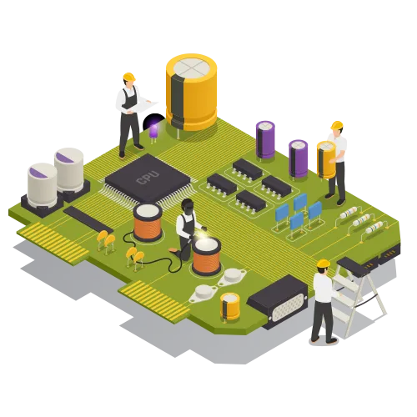
5) PS-4 Controller
6) 3D Prints or Laser Cut Material
7) PCB Breakout Board

Slide 12




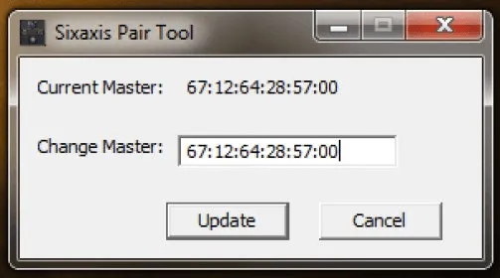
resources Required
Software with version
2) KiCAD / Altium Designer
Fusion 360
3) Arduino IDE 2.2.1
4) SixAxisPairTool

Slide 13
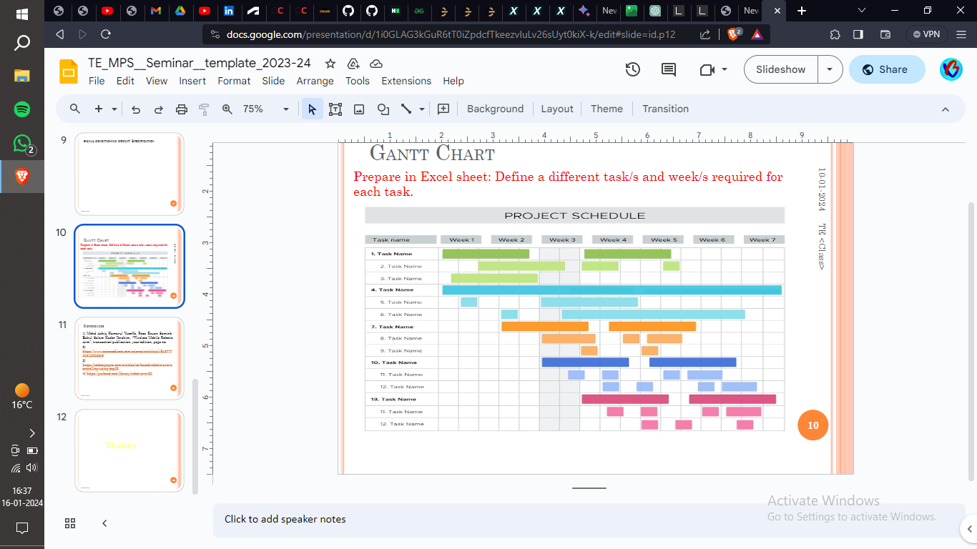
Gantt Chart
Sr. No. | Task Name | Week 1 | Week 2 | Week 3 | Week 4 | Week 5 | Week 6 | Week 7 | Week 8 | Week 9 | Week 10 | Week 11 | Week 12
1 | Research & Documentation
2 | CAD Design
3 | Electronics Research
4 | Mechanical Manufacturing Chassis
5 | Electronics Development
6 | Mechanical Manufacturing Robotic Arm
7 | Coding and Planning
8 | Mechanical Final Assembly
9 | Electronics Assembly and Testing
10 | Coding and Complete Integration
11 | Final Assembly and Testing

Slide 14
References
Mohd Ashiq Kamaril Yusoff's, Reza Ezuan Samin, Babul Salam Ksm Kader Ibrahim, “Wireless Mobile Robotic Arm”, ELSEVIER, ResearchGate, December 2012, 1072-1078.
https://iotdesignpro.com/articles/iot-based-robotic-arm-controlling-using-esp32
https://www.academia.edu/50180450/Design_and_implement_of_robotic_arm_and_control_of_moving_via_IoT_with_Arduino_ESP32
https://ozrobotics.com/shop/hiwonder-maxarm-robot-arm-powered-by-esp32-support-python-and-arduino-programming-standard-kit/
https://www.researchgate.net/publication/333886109_A_Cost-Efficient_Multipurpose_Service_Robot_using_Raspberry_Pi_and_6_DOF_Robotic_Arm
https://grabcad.com/library/robot-arm-83
https://docs.google.com/spreadsheets/d/1wXcu2AezT9oymwPx0rUag4GGjRIw_IFt9GSfBZX83_Y/edit#gid=0
10-01-2024

Slide 15
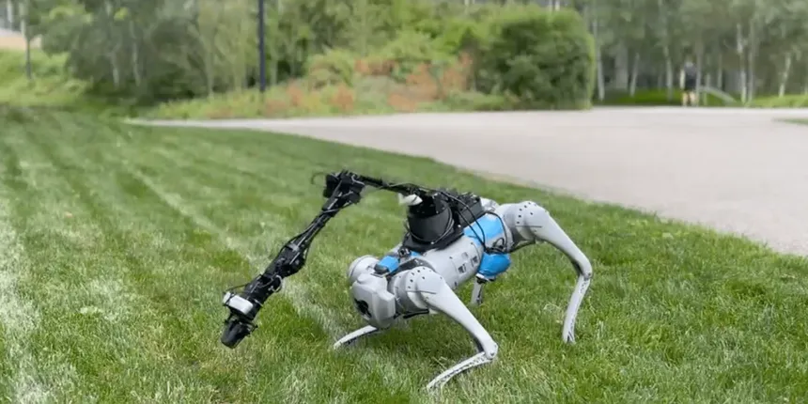
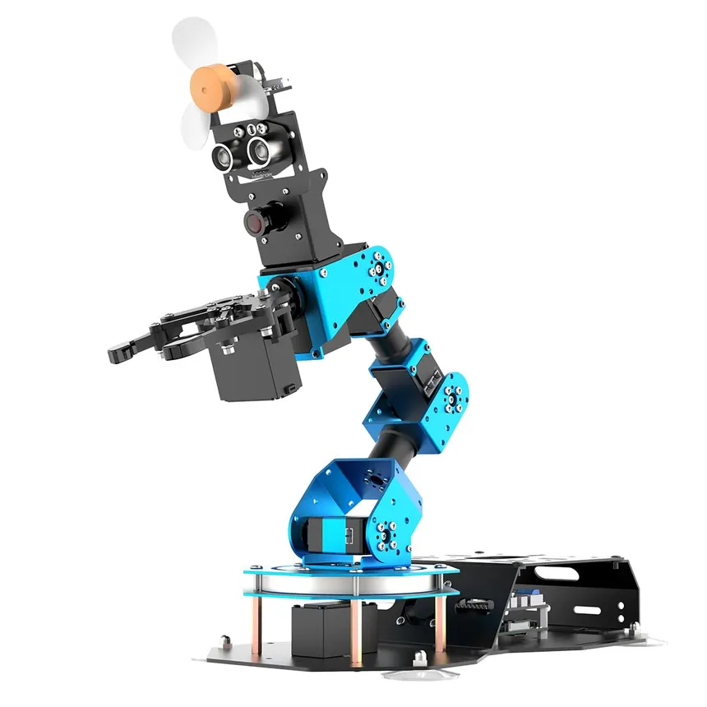
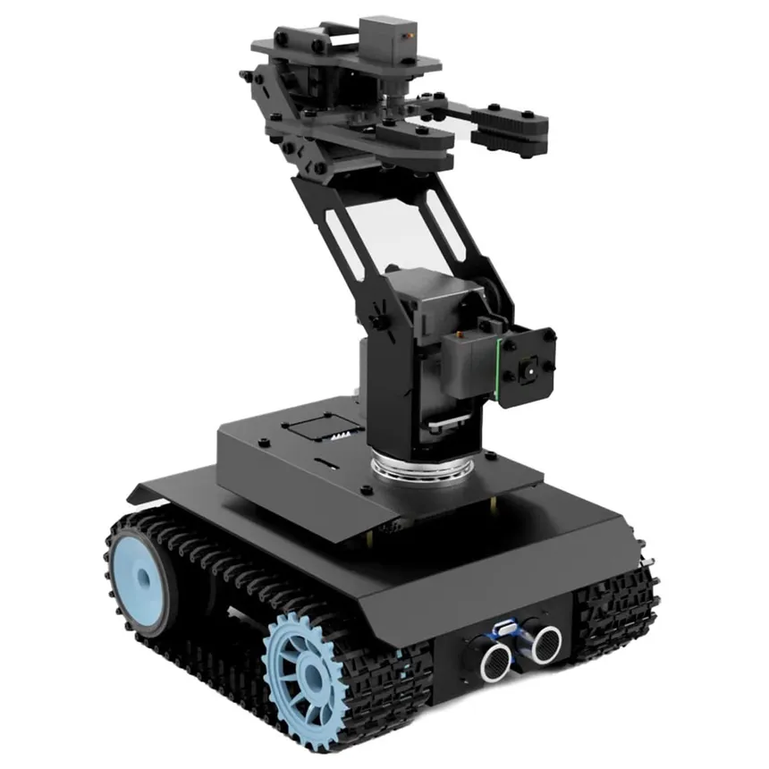
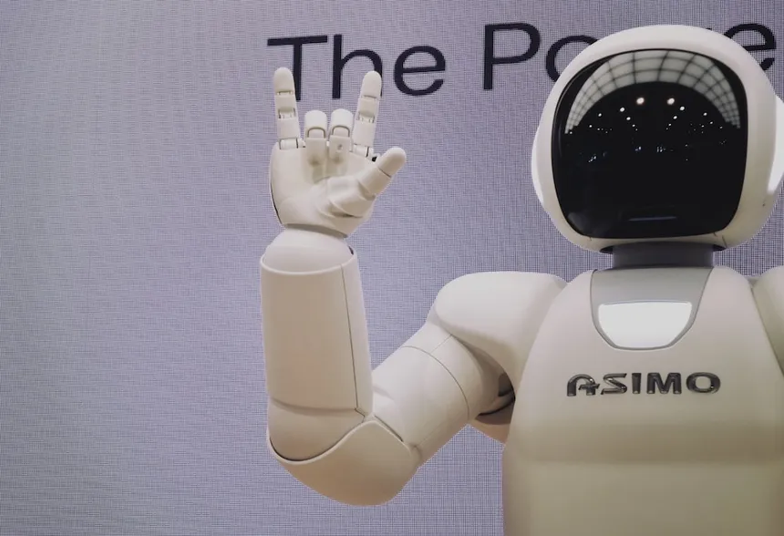
Thanks

